Slide 1
Quotes For Anyone And
Everyone..
Pitch Deck

Slide 2
What is Proquotes ?
Proquotes gives you the opportunity to create and upload your thoughts in the form of text quotes, image quote and video quotes Proquotes was conceptualized and designed to reach into the deepest crevices of our heart, making us feel a gamut of emotions and leaving a lasting impression on us.

Slide 3
Features
Create your own quotes
One of the key features of Proquotes is that it allows its users and subscribers to create their own quotes with different format. Our subscribers and users can create quote simply in the text , image or video and other formats.
User friendly
The application is extremely easy to navigate be it to access the quotes or to design you own quotes it does require a complex and complicated process. Also users/ subscribers can login into the application using Google or Facebook.
Notifications
Notifications are a great way of knowing what is the current activity taking place on the application, without actually opening the application. Also when subscribers create their own quotes , they can be notified if anyone has commented or liked their quotes.
Safety First
The safety of our subscribers/users is our top priority, we have made sure we have provided a space for our users to report abuse or also report any content they find offensive. We also have given the user/subscriber to block content they find offensive.
Diversity
Proquotes updates their quotes twice a month, it also allows its users to create their own content, providing them with new and exciting content. They can upload content in the form of video, text and image quotes.
Advertisement
Proquotes offers a space for advertisement. Businesses that would like to access a wider base for their products can use this space to advertise. We offer two types of advertisements : Pop-Up and Banner

Slide 4
Categories
View quotes from 100+ predefined categories or Create your own
Beauty
Birthday
Chance
Communication
Courage
Dreams
Education
Environment
Failure
Faith
Famous People
Forgiveness
Friendship
Funny
God
Happiness
Inspirational
Intelligence
Love
Mom
Motivational
Positive
Relationship
Respect
Smile
Strength
Thankful
Trust
Wisdom
Worship

Slide 5
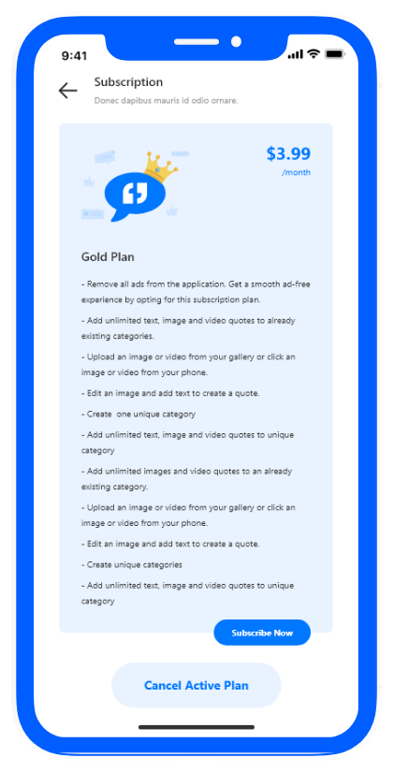
Revenue Model
Add your own video quotes, scribble on that or make your audio quotes for just $3.99 per month.
Create your own category and share with your friends .

Slide 6
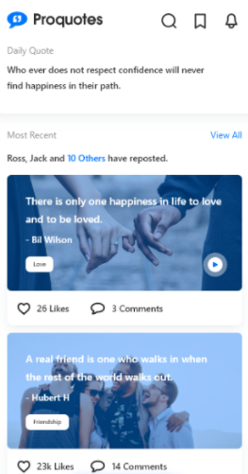
Two different advertisement panels to manage full page advertisements and slider base advertisement. Earn $100K a month
Advertisement
Footer Ads view
Full Screen Ads view

Slide 7
Competition
Motivation – Daily Quotes has $2 M estimated revenue.
I am – Daily Affection has $1.2 M estimated revenue.
Vocabulary – Learn New Words has $500 K estimated revenue.
Daily Random Facts has $300 K estimated revenue.
Laugh My App has $300K estimated revenue.

Slide 8
Expected Growth
Financial Projections for year 2022-2024

Slide 9
Expected Users Growth

Slide 10
Expected Revenue Growth

Slide 11
Thank you

